Slide 1
The activities of the IAPG - International Association for Promoting Geoethics: status and future perspectives
Giuseppe Di Capua
giuseppe.dicapua@ingv.it
Silvia Peppoloni
silvia.peppoloni@ingv.it

Slide 2
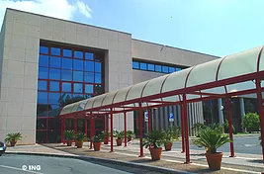
The IAPG: Mission, Status, Organization
A multidisciplinary platform for widening the discussion and creating awareness about values and problems of ethics applied to the geosciences.
Founded in 2012 (34th IGC, Brisbane, Australia)
Scientific, non-governmental, non-political organization
Legally registered as NGO
More than 2660 members in 130 countries on 5 continents
Executive
Council
General
Assembly
Early Career Scientists Team
Organization
32
National Sections
Board of Experts & Delegates
3
Task
Groups
IAPG Head Office, c/o INGV, Rome, Italy

Slide 3
Topics
IAPG works for developing theoretical and practical activities covering a wide range of contents:
philosophy of geosciences and history of geosciences thinking
sociological aspects in geosciences and geoscience-society-policy interface
research integrity, professionalism in geosciences, working climate issues and related aspects
geosciences for sustainable and responsible development
geoethics in georisks and disaster risk reduction
geoethical implications in global and local changes of socio-ecological systems
responsible georesource management
ethics in geoengineering
ethical and social aspects in geo-education and geoscience communication
ethical issues in climate change and ocean science studies
geoethics applied to different geoscience fields including economic geology, paleontology, forensic geology, and medical geology
ethical implications in geoscience data life cycle and big data
ethical and societal relevance of geoheritage and geodiversity
ethical and social matters in the international geoscience cooperation

Slide 4
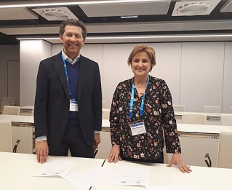
Networking
IAPG promotes geoethics through the international cooperation with Associations, Organizations and Institutions
7
25
5
affiliations
agreements
partnerships

Slide 5
Strategy 2019-2022
Projects
Networking
Lectures
SpringerBriefs in Geoethics
Conferences
Journal of Geoethics and Social Geosciences
Society
School
on Geoethics
Publications

Slide 6
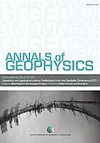
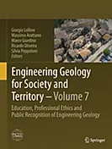
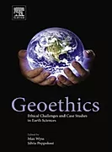
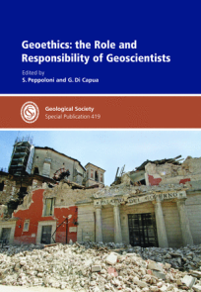
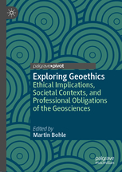
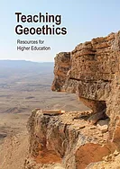
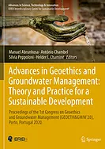
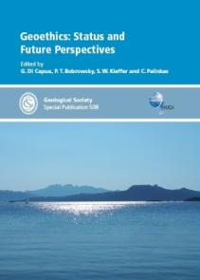
Publications
2012
2014
2014
2015
2017
2018
2019
4 new books
in preparation
2020
2020
2021
2021
2021

Slide 7
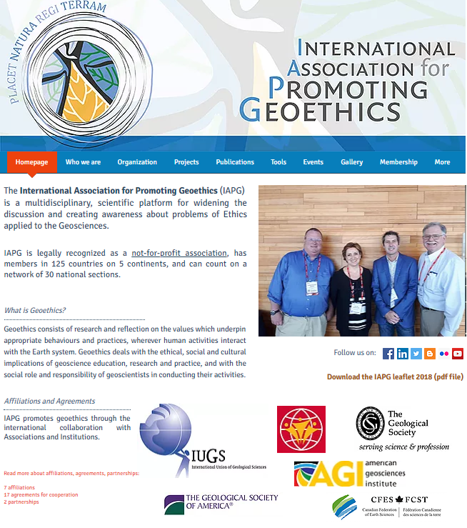
IAPG website and social media
Who we are
Organization
School on Geoethics
Projects
Publications
Tools
Events
Membership
Links
www.geoethics.org
Contact us

Slide 8
Thanks for yoUr attention
Giuseppe Di Capua
Istituto Nazionale di Geofisica e Vulcanologia
giuseppe.dicapua@ingv.it
Silvia Peppoloni
Istituto Nazionale di Geofisica e Vulcanologia
silvia.peppoloni@ingv.it

